Slide 1
Interpretable Visual Features for Demand Neuroforecasting
Brenden Eum
Brian Knutson
Shabnam Hakimi
Remi Daviet
Ryan Webb

Slide 2
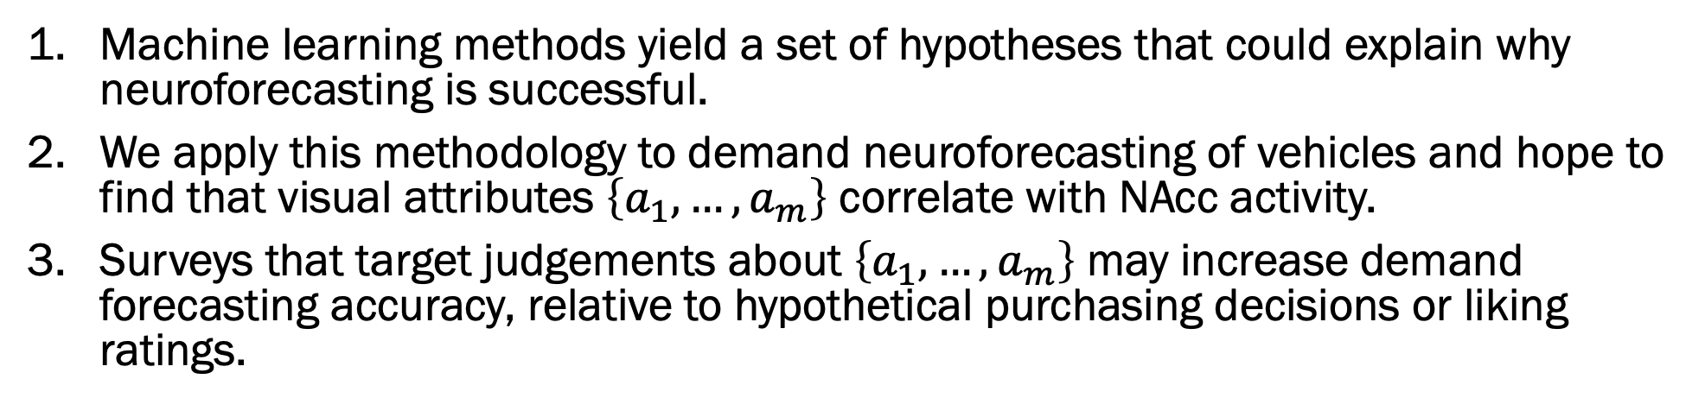
End Goal (replace with Key Takeaways later)
Machine learning methods yield a set of hypotheses that could explain why neuroforecasting is successful.
We apply this methodology to demand neuroforecasting of vehicles and hope to find that visual attributes $\left\{a_{1}, …, a_{m}\right\}$ correlate with NAcc activity.
Surveys that target judgements about $\left\{a_{1},…,a_{m}\right\}$ may increase demand forecasting accuracy, relative to hypothetical purchasing decisions or liking ratings.
Importance
Neuroscience | Marketing
Methods from machine learning can be used to suggest a limited set of hypotheses about functionality in a brain ROI, especially in regions dealing with early affect and visual features. | Explains why inclusion of alternative forms of data (like images) in demand forecasting can improve prediction.

Slide 3













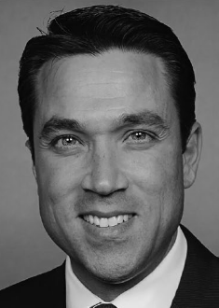
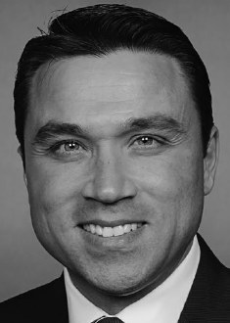
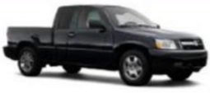

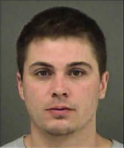
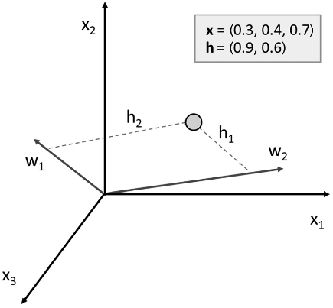
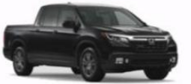

Venkatraman et al. (JMR)
Christiano et al.?
Genevsky, Yoon, Knutson (J Neuro)
Srirangarajan et al.?
Berns & Moore (JCP)
Genevsky & Knutson (Psych Sci)
Tong et al. (PNAS)
2012
2014
2016
2018
2020
2022
2024
Lin, Adolphs, Alvarez (Psych Sci)
Ludwig & Mullainathan (QJE)
Burnap et al. (Market Sci)
Burnap et al. (J Mech Des)
Sisodia et al. (JMR)

Slide 4
Christiano et al.?
NAcc activity linked to out-of-sample market outcomes
Venkatraman et al. (JMR)
Genevsky, Yoon, Knutson (J Neuro)
Srirangarajan et al.?
Berns & Moore (JCP)
Genevsky & Knutson (Psych Sci)
Tong et al. (PNAS)
2012
2014
2016
2018
2020
2022
2024
Methods for identifying visual features
Lin, Adolphs, Alvarez (Psych Sci)
Ludwig & Mullainathan (QJE)
Burnap et al. (Market Sci)
Burnap et al. (J Mech Des)
Sisodia et al. (JMR)

Slide 5
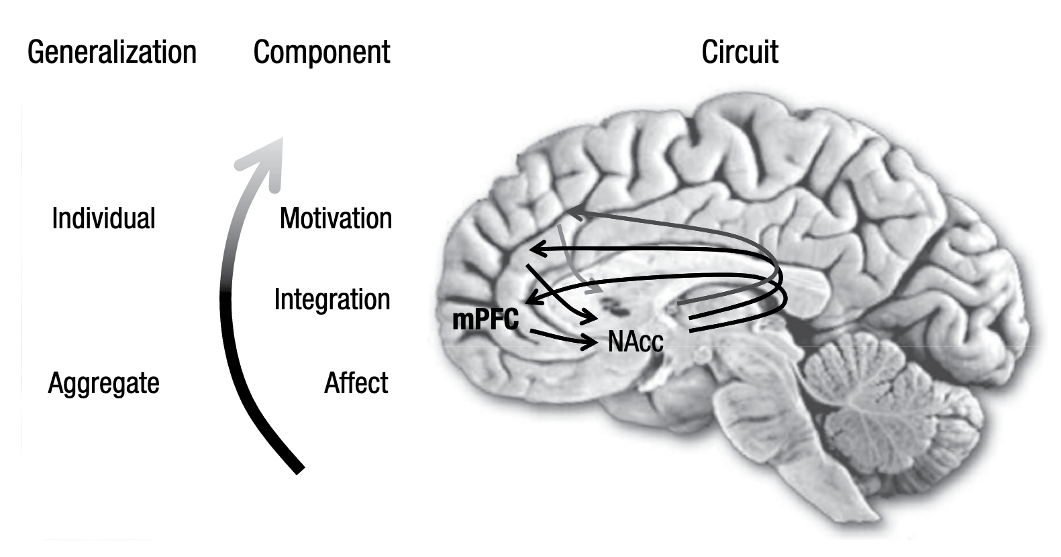
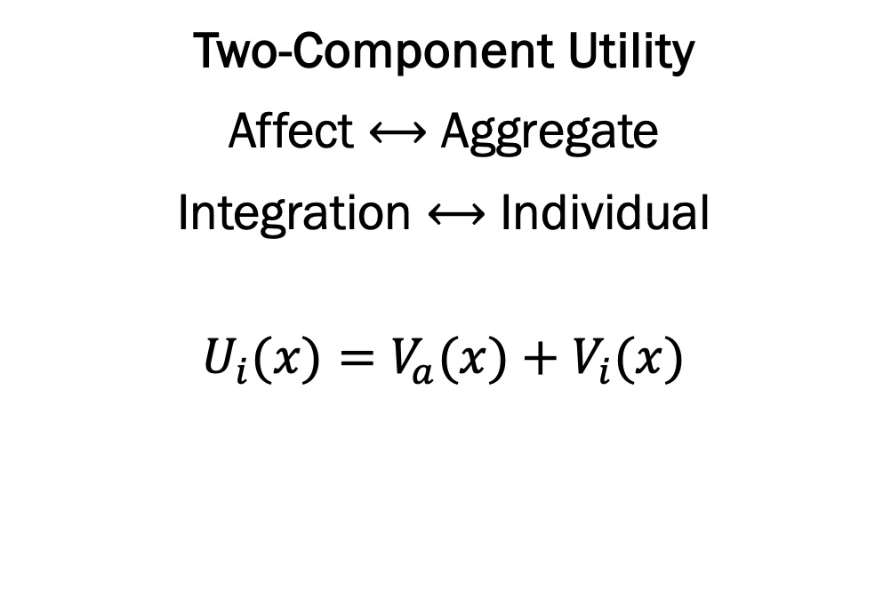
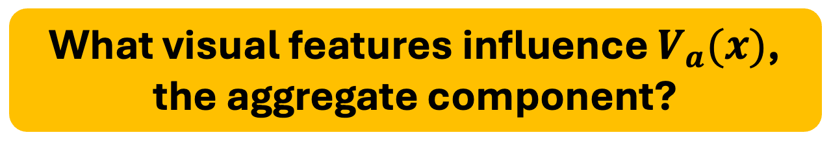
Why does NAcc activity contain signal about market-level outcomes?
Affect-Integration-Motivation Network
Two-Component Utility
Affect ⟷ Aggregate
Integration ⟷ Individual
$$U_{i}(x)=V_{a}(x)+V_{i}(x)$$
What visual features influence $V_{a}(x)$, the aggregate component?
Knutson & Genevsky (2018, Cur Dir Psych Sci); Genevsky, Tong, Knutson (2025, PNAS Nexus)

Slide 6
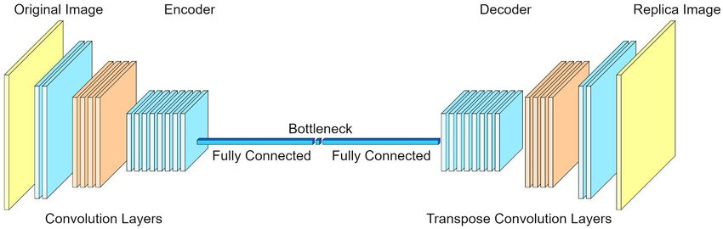
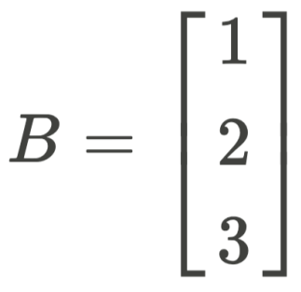
Variational autoencoders for feature discovery
“learned features important for drawing vehicles”

Slide 7
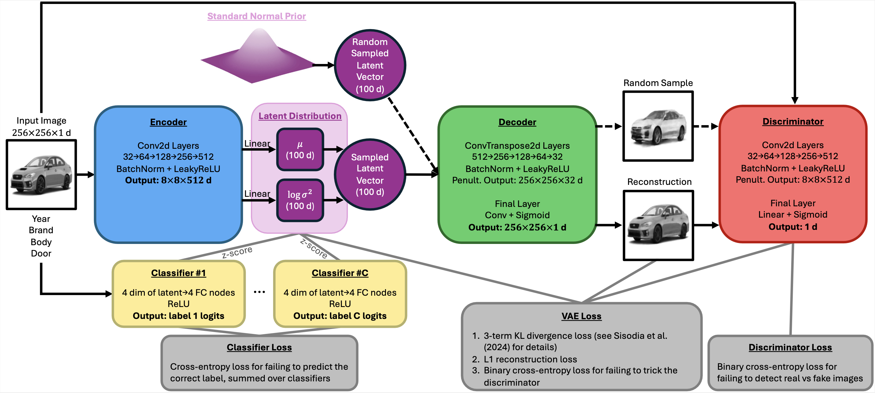
Variational autoencoders for feature discovery
architecture to encourage “disentanglement”
“learned features important for drawing vehicles”

Slide 8
Variational autoencoders for feature discovery
Hood Curvature
“learned features important for drawing vehicles”
Grill Shape
Headlight Slant

Slide 9
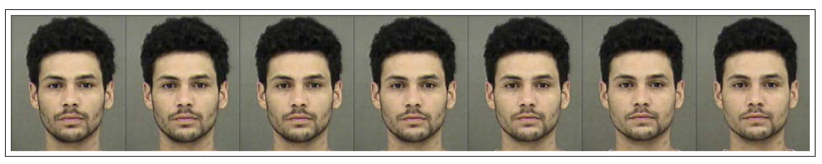
Latent traversal surveys for feature interpretation
-2
-1
0
2
3
4
What is changing from left to right?
Ludwig & Mullainathan (2024, QJE)

Slide 10
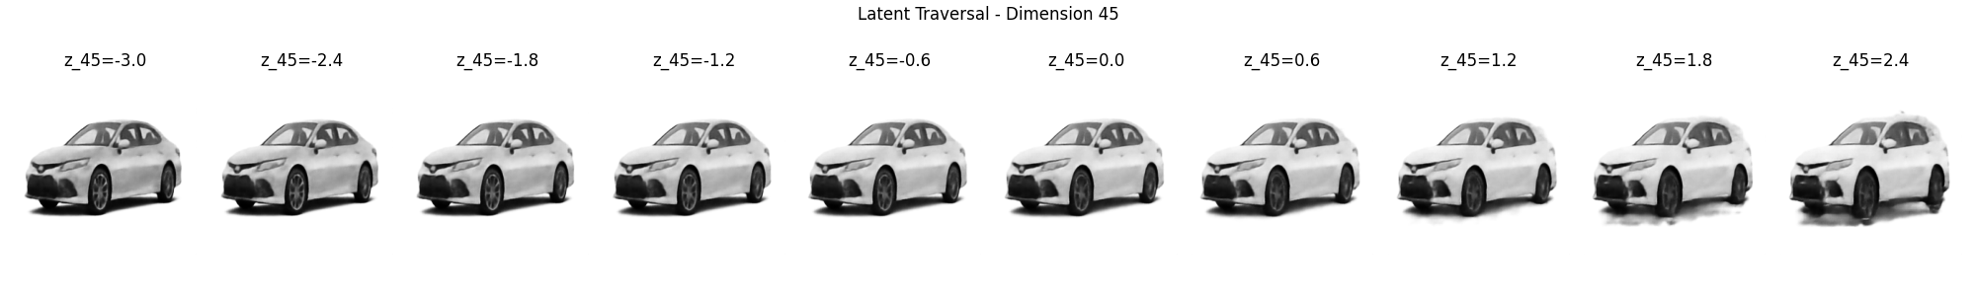
Latent traversal surveys for feature interpretation
-2
-1
0
2
3
4
What is changing from left to right?

Slide 11
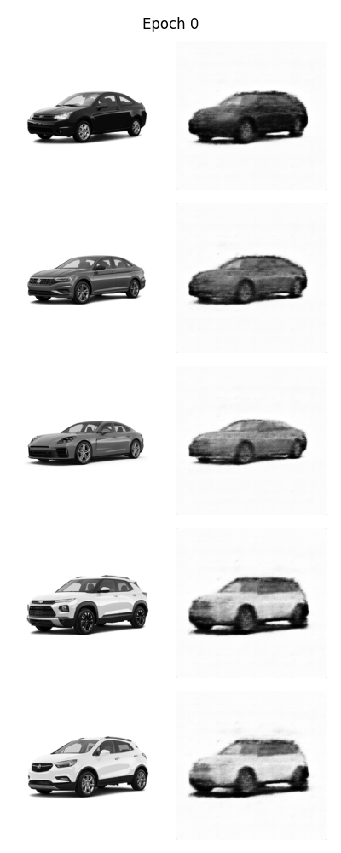
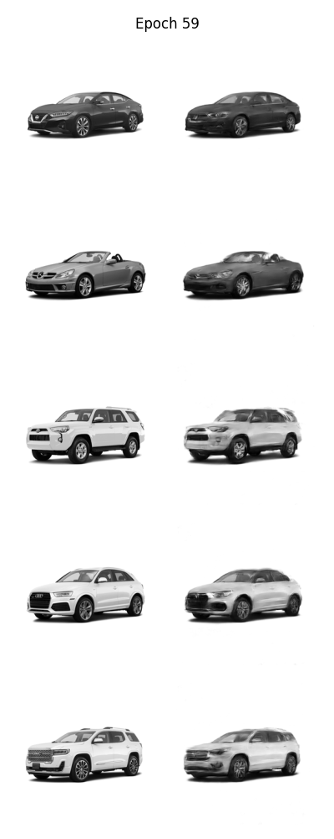
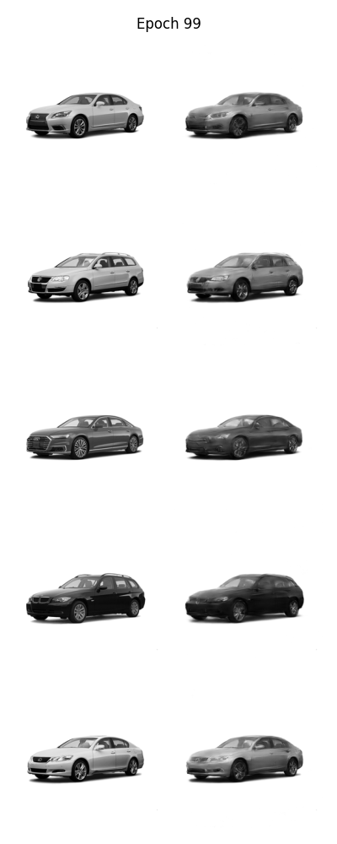
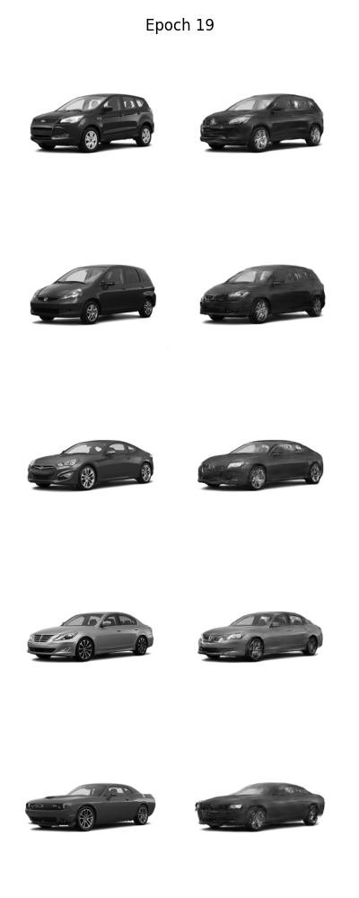
Where we’re at now: grid search for stable training
res256_lat128_ep200_bat71_lrn0.0001_rec100.0_per5.0_gan0.2_kld0.75(tc0.002_mi0.1_dk2e-05)_cls0.2_pat16
res256_lat128_ep200_bat71_lrn0.0001_rec150.0_per2.0_gan0.2_kld0.2(tc0.002_mi0.1_dk2e-05)_cls0.2_pat16

Slide 12
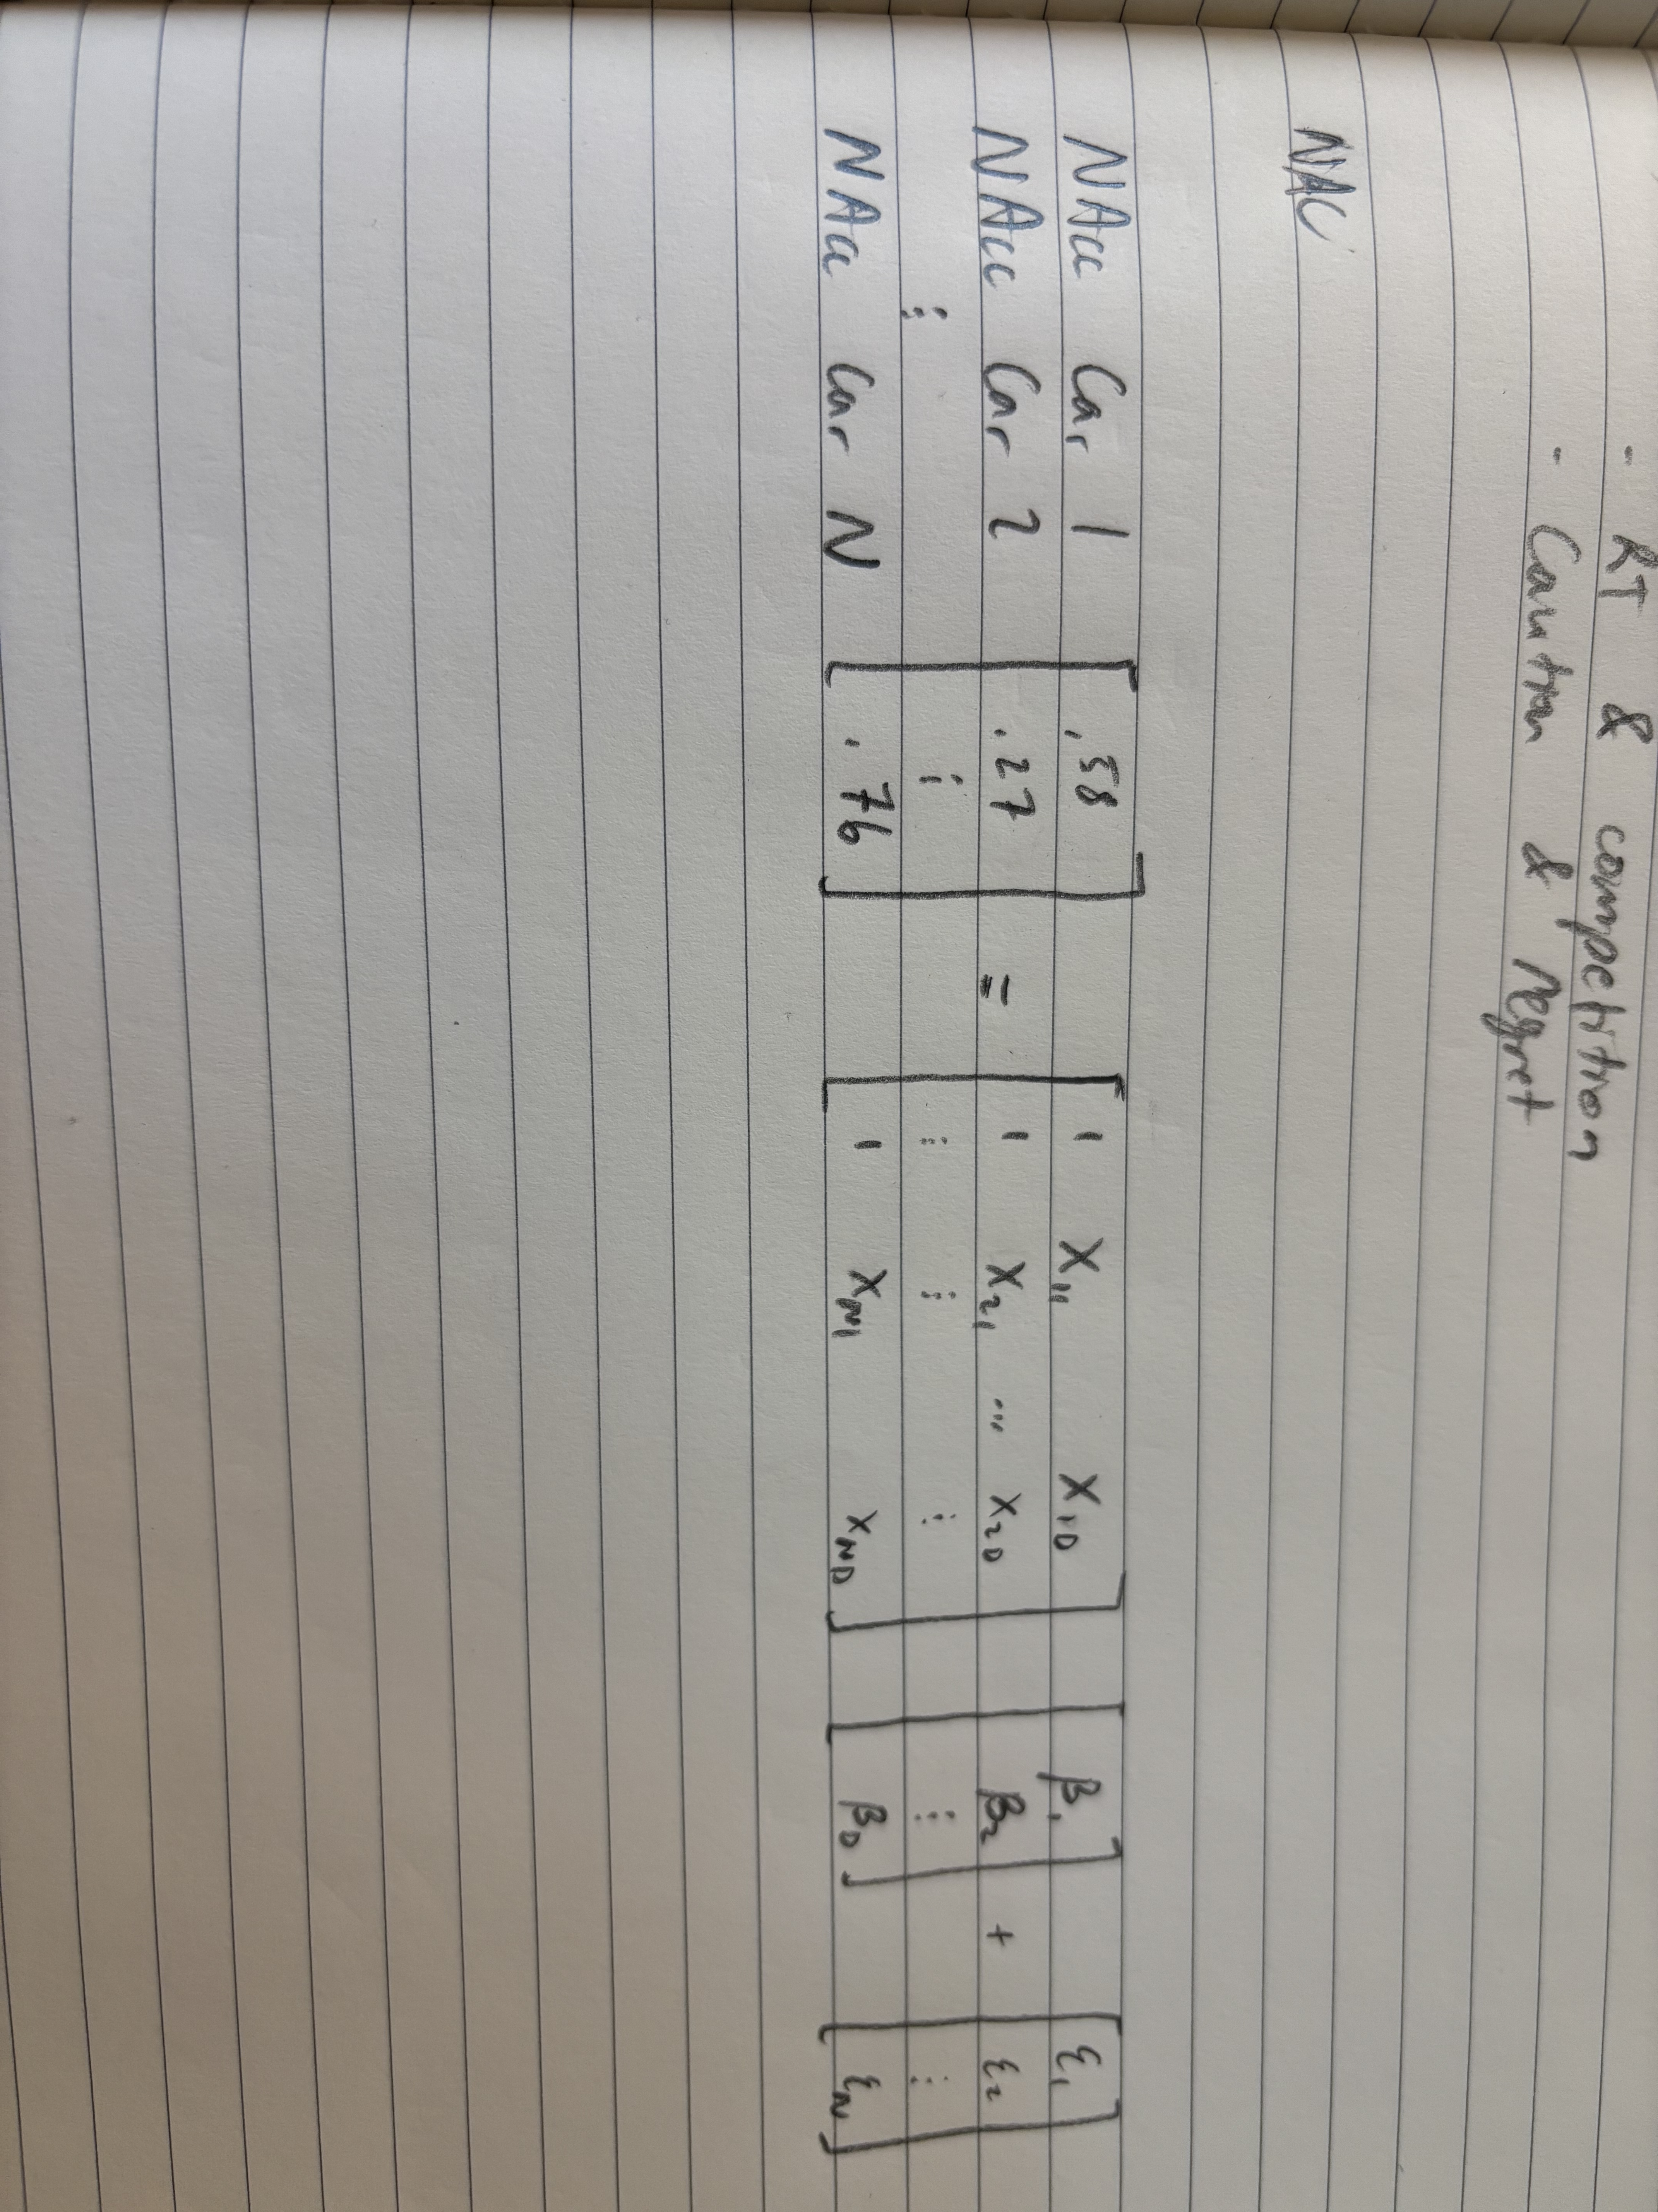
Next Steps
What latent dimensions correlate with NAcc activity?
Use latent traversal surveys to give interpretation to the significant dimensions.
Design NAcc-inspired surveys (e.g. judgements about these significant features). Outperform hypothetical purchasing decisions and liking ratings?

